Slide 1
Component 1: PCB ITS Case Study – Concept of Operations (ConOps)
February 25, 2017

Slide 2
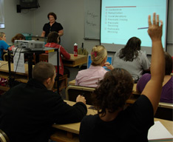

Case Study Format and Purpose
Case Study Purpose
Provide overview of Concept of Operations (ConOps) development for Intelligent Transportation Systems (ITS) as part of a Systems Engineering (SE) process
Components
1: Presentation (this part)
2: Take Home Exercise
3: Debrief
Notes:
Purpose of Slide: Introduce purpose of the case study.
Key Message: This case study provides an overview of Concept of Operations development in the context of a Systems Engineering process.
Time on Chart: 1 minute
Suggested Comments: This case study will introduce you to developing a Concept of Operations, ConOps for short, to support Intelligent Transportation Systems (ITS) projects. The Concept of Operations is one of the key components of the System Engineering process required by the Federal Highway Administration. The Case Study assumes an understanding of ITS concepts. There are 3 components to this case study. This presentation will provide the background and discussion for Concept of Operations development. You will be given a take home exercise to further expand your learning experience. You will report you findings during a debriefing to close this case study. Unfortunately, there are a lot of acronyms in Intelligent Transportation Systems (ITS) and Systems Engineering (SE) including the Concept of Operations (ConOps).
Transition:
Interactivity:
Additional Resources:

Slide 3
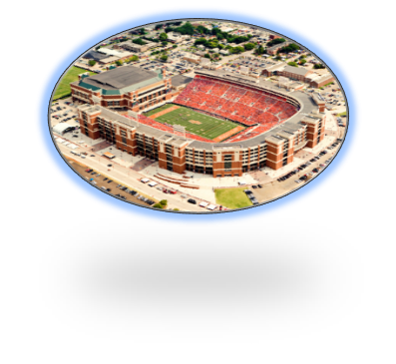
Exercise Case Study Overview
Develop Stadium Expansion Concept of Operations (ConOps) Case Study
Scenario
University Football Stadium traffic congestion
Planned events
Growing attendance/traffic
Stadium expansion
City transportation system cannot accommodate demand
Student Role
City Traffic Engineer
Systems Engineer
Resources
ConOps outline
Notes:
Purpose of Slide: Provide students a preview of the exercise so they know what they will be doing and can relate the lecture to their task.
Key Message: In the exercise, students will define some draft input to a set of stakeholder user needs for the PCB Case Study from the perspective of the traffic engineer working for the state.
Time on Chart: 1 minute
Suggested Comments: The exercise you will be doing in Component 2 develops some of the parts of a Concept of Operations including a list of stakeholders, their corresponding systems or elements as well as an initial set of stakeholder user needs for the University Stadium Case Study. The project scenario revolves around a university football stadium and the traffic congestion that has begun to be a problem during games. In this exercise scenario, our football team has been having increasing success over the past few years and attendance at games has increased to stadium capacity. This capacity draw has put enormous strain on the roadway network around the stadium to the point where the City has to find a solution to remedy the problem because of the traffic congestion on game day. On top of that, the university, playing on the success of the team and the requests of alumni, has decided to expand the stadium capacity which will magnify the congestion problem.
Your role in the exercise will be the City Traffic Engineer who needs to use Systems Engineering. Your task will be to assure that the needs of the city, university and state are accurately and completely represented in a draft ConOps.
Transition:
Interactivity:
Additional Resources:

Slide 4
Exercise Activities
Task 1: Identify Stakeholders
Determine who is involved
Roles and Responsibilities
Task 2: Current Situation
Operations
System Elements and Connections
Task 3: Justification for Change
User needs
Description of Desired Changes
Task 4: Concepts for Proposed System
Policies and constraints impacting the system
Description of the proposed system
Identify Stakeholders
Current Situation
Justification for Change
Concepts for Proposed System
Notes:
Purpose of Slide: Describe the exercise tasks.
Key Message: The exercise will consist of specific topics that will be discussed in this presentation.
Time on Chart: 1 minute
Suggested Comments: The exercise will consist of 4 tasks as listed on this slide. The objective is to define the concept of the project with added elements in each step. Task 1 will identify the stakeholders. Stakeholders are primarily the users of the system but can also be the owner, funding agency or maintainer of the system. Task 2 will explain the current situation. Task 3 will produce a justification for changes. Finally, Task 4 will develop supporting concepts for the proposed system. So that’s the exercise and I hope understanding the scope of the tasks will help you grasp the information you need from the remainder of this presentation.
Transition:
Interactivity:
Additional Resources:

Slide 5
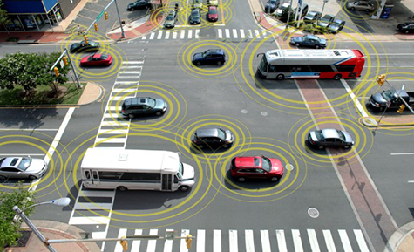
What is Intelligent Transportation Systems (ITS)?
Transportation project involving one or more systems and/or one or more ways to communicate electronically
Examples
Smartphone Transportation Applications
Weigh in Motion for commercial vehicles
Adaptive Traffic Control Signals
Traffic Management Center
Traffic Signal Priority
Connected Vehicles
Notes:
“ITS” or Intelligent Transportation Systems involves surface transportation systems made of hardware and software that communicate electronically to other systems.
ITS addresses local transportation needs by providing information to travelers, transportation agencies and organizations so that they can make informed decisions about their travel and operations.
A Traffic Management Center or TMC is a common example of an ITS implementation that could provide a number of services. Larger TMCs can be housed in custom facilities, frequently with DOTs and other public service providers such as public safety agencies. Smaller TMCs can be located in Engineering department offices.
It is important to note that ITS does not solve the entire transportation problem. Congestion does not necessarily disappear after ITS is applied. ITS helps the transportation system operator manage the traffic congestion more effectively and helps the traveler make decisions that improves their travel experience.
Connected vehicles graphic: http://its.dot.gov/cv_basics/cv_basics_what.htm

Slide 6
ITS Addresses Transportation Needs
Delivers transportation services that address local needs
Defines transportation systems and functions needed to deliver services
ITS does not solve the entire transportation problem
ITS provides tools to better manage existing transportation conditions and maximize the capacity and capabilities of current facilities
ITS enables travelers to be better informed, make safer and smarter use of transportation systems
Notes:
Purpose of Slide: Introduce that ITS systems that work together to provide ITS services.
Key Message: ITS delivers services but by itself does not solve the entire transportation problem.
Time on Chart: 2 minutes
Suggested Comments: ITS addresses local transportation needs by providing information to travelers, transportation agencies and organizations so that they can make informed decisions about their travel and operations. ITS addresses the needs in the form of services that are provided such as traveler information or incident management. To provide these services, transportation systems and functions are defined that deliver the services or make them possible. What we are going to discuss from this point forward is what makes up ITS in the form of transportation systems and what information is exchanged between these systems to deliver ITS services.
It is important to note that ITS does not solve the entire transportation problem. Congestion does not necessarily disappear after ITS is applied. ITS helps the transportation system operator manage the traffic congestion more effectively and helps the traveler make a decision that improves their travel experience.
Transition: So what is ITS made of?
Interactivity:
Additional Resources:

Slide 7
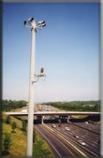
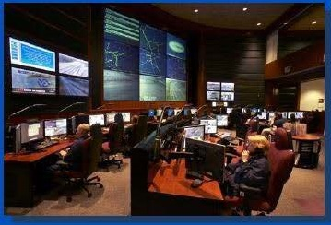
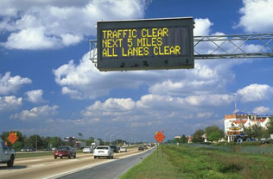

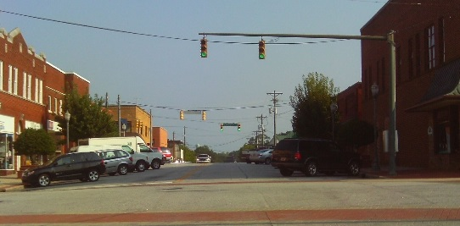
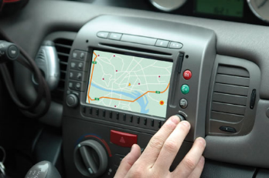
Intelligent Transportation Systems (ITS) Example
Traffic Management Center (TMC)
Interacts with devices
Dynamic Message Signs (DMSs)
Traffic cameras
Highway Advisory Radios (HARs)
Traffic detection
Traffic signals
Personal Devices
Notes:
Purpose of Slide: Provide an example a common ITS deployment.
Key Message: The TMC interacts with devices to obtain and disseminate information and control devices such as traffic signals.
Time on Chart: 2 minutes
Suggested Comments:
A Traffic Management Center is a common ITS implementation. Larger TMCs are housed in purpose built facilities, frequently with DOTs and other public service providers such as police, fire, rescue, and transit collocated. Smaller TMCs can be located in Engineering department offices.
To fulfill its role, a TMC will interact with a variety of field devices or other systems. Typical field devices include surveillance cameras (usually with pan-tilt-zoom capability) and traffic sensors for most centers. Centers that manage freeways additionally interact with devices such as dynamic message signs, highway advisory radio transmitters, and ramp meters. Centers that manage arterials additionally interact with devices such as traffic signals. Interaction with personal devices is becoming more common, especially for transit applications and developing Connected Vehicle applications. The Concept of Operations will described the interactions with the devices and systems.
Transition:
Interactivity:
Additional Resources:
Referenced TMC picture from a presentation on Georgia Navigator 511: http://fr.slideshare.net/Franciel/georgia-navigator-511
Referenced Portable DMS: http://www.coralsales.com/its/itemlist/category/43-portable-trailers-message-boards
Referenced Signal picture from Iteris, Inc.
Referenced diagram and DMS, freeway, and GPS photos from Iteris, Inc.
Referenced camera pole photo from http://www.511ga.org/#

Slide 8

Putting “ITS” Together
ITS has many systems, interactions, and institutions
How does it all fit together?
How do the various components interact?
What can be used to coordinate deployment?
USDOT defined the National ITS Architecture (www.iteris.com/itsarch)
Common definition for ITS terminology and communication
Guide for ITS deployment planning
Defines what is “ITS” in the United States
Traffic
Vehicles
Payment
Transit
Devices
Centers
Notes:
Purpose of Slide: Introduce the National ITS Architecture via its purpose.
Key Message: ITS has diverse components and a framework is needed to connected the various components.
Time on Chart: 2 minutes
Suggested Comments: ITS brings together different modes (transit, traffic, freight, rail), using different communications media (wireless, wireline, vehicle to vehicle), and numerous organizations (state/local government, law enforcement, emergency management, private industry). The benefits of ITS are realized when all of these systems are able to efficiently coordinate their operations and easily exchange the information they have and need. To accomplish the integration of ITS, a framework is needed to functionally describe the subsystems required, the information exchanges between them and the institutions who operate each subsystem. That framework exists as the National ITS Architecture. Published in 1996 at the direction of Congress and under the management of USDOT, the National ITS Architecture provides a functional representation of ITS for organizations to plan and deploy their ITS in a coordinated and effective manner. The National ITS Architecture defines what is “ITS” in the United States!
Transition:

Slide 9
Systems Engineering (SE)
Systems Engineering (SE) focuses on the “system” as a whole emphasizing its total operation
Views the “system” from the outside as well as the inside
Concerned about interactions of the “system” with other systems and the environment
Traces the user needs from “system” conception through design/development and into operations and retirement
Involves and manages multiple disciplines working together
Defines a process useful for controlling system cost and schedule making it an inherent part of project management
Balances competing needs/constraints
Notes:
Purpose of Slide: Explain Systems Engineering
Key Message: SE focuses on the whole system, not the individual parts.
Time on Chart: 2 minutes
Suggested Comments: Systems engineering addresses the system as a whole. It examines the system from all perspectives and is concerned with the interactions with other systems and its operating environment. The foundation of systems engineering is based in the needs of the system through its entire life cycle from concept to retirement. Systems engineering involves many disciplines and is part of project management since system development processes heavily influence cost and schedule controls. ITS involves multiple disciplines, a broad range of stakeholders, and transportation needs that affect many users. Systems Engineering can and should be used for ITS and transportation projects to properly address system development.
Transition:
Interactivity:
Additional Resources:

Slide 10
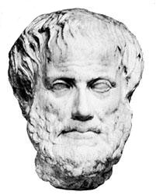
“The whole is more than the sum of its parts.”
Aristotle, 384 BC – 322 BC
Notes:
Purpose of Slide: Emphasize the systems engineering approach
Key Message: SE focuses on the whole system, not the individual parts.
Time on Chart: 2 minutes
Suggested Comments: This quote from Aristotle reflects what systems engineering is all about. It can be applied to people working together or developing integrated systems. In ITS there are benefits and value in sharing your information with others.
Transition:
Interactivity:
Additional Resources:

Slide 11
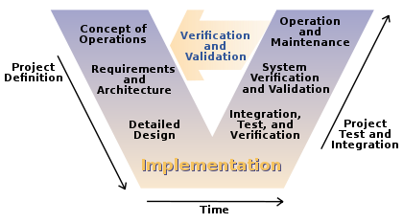
Systems Engineering “V” Lifecycle Process
Notes:
Purpose of Slide: Introduce the Systems Engineering lifecycle process
Key Message: This V diagram depicts the systems engineering lifecycle process
Time on Chart: 2 minutes
Suggested Comments: The V diagram depiction of the systems engineering process includes Project Definition activities on the left-hand side and Project Integration and Test activities on the right-hand side. The system concept is essentially decomposed into details that dictate implementation or build. The system is then composed or assembled and integrated into the system solution along with testing each component assembly. An important concept is that the System Testing is conducted against the Needs and Requirements defined at the beginning of the project.
The International Council on Systems Engineering (INCOSE) defines Systems Engineering as “an interdisciplinary approach and means to enable the realization of successful systems. It focuses on defining customer needs and required functionality early in the development cycle, documenting requirements, then proceeding with design synthesis and system validation while considering the complete problem.”
Since it was first developed in the 1980s, the systems engineering "V" model has been refined and applied in many different industries.
Transition:
Interactivity:
Additional Resources:

Slide 12
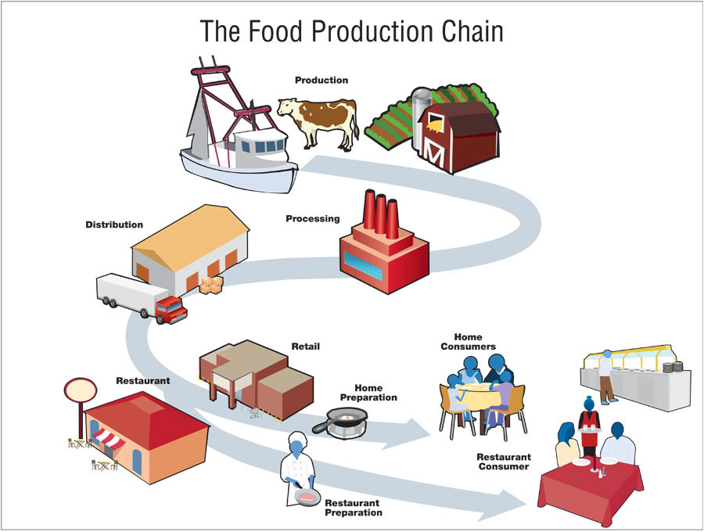
Key Concept - Traceability
Traceability is the glue that holds the SE process together
Each step in the SE process relates to the previous steps and to the next steps – ensures continuity is enforced
Traceability will become clearer as we develop our Concept of Operations within the SE approach
Notes:
Purpose of Slide: Introduce the concept of Traceability
Key Message: Traceability is an example of cross-cutting activities in the Systems Engineering process
Time on Chart: 2 minutes
Suggested Comments: The concept of traceability is what holds or ties the Systems Engineering process together. Each step in the Systems Engineering process is related to the previous steps and the following steps forming a relationship chain. User needs trace to requirements and requirements trace to design and design traces to testing which traces back to requirements and user needs. Traceability relates the system that is built to the needs and requirements that initiated its development.
Think about our food delivery system in the United States. Why is it important to know where our food comes from, what factories are used to process it? This is the same idea for system traceability.
Graphic: Graphic courtesy of the Centers for Disease Control and Prevention, http://harvestpublicmedia.org/article/1463/struggle-trace-produce-farm-table/5

Slide 13
Key Concept – Push technology decisions as close to Implementation as possible
Why is this concept important?
Do you really want to be using a computer system specified 5 years ago in a new project?
Security support, patches, updates last how long?
Emphasis in the initial stages of SE to be:
General
Abstract
Functional
High-level
Notes:
Purpose of Slide: Introduce another very important concept about pushing technology decisions as close to implementation as possible.
Key Message: Due to the changing nature of technology, it is important to make technology decisions as close to system implementation as possible
Time on Chart: 2 minutes
Suggested Comments: Another key concept that is central to Systems Engineering involves technology choices.
Technology, including hardware, software and communications, is constantly evolving. In order to best manage these changes, it is important to make technology decisions as close to system implementation as possible.
Avoid specifying products in the SE documentation, instead be general, abstract, functional and high-level but with enough specificity to bound subsequent desired technology choices that meet user needs and requirements.
Transition:
Interactivity:
Additional Resources:

Slide 14
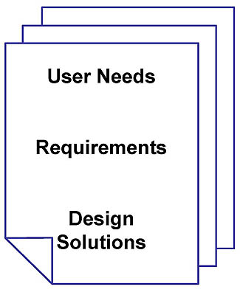
Key Concept – Specification
Initial goal is to develop a specification to be used for procurement
Identify and write description of what the system, equipment and interfaces must do to support operations (features-functions)
Develop and Write (in “shall” language) specific functional requirements to satisfy user needs
Map standard-supplied design concepts-solutions to fulfill the project requirements
Notes:
Purpose of Slide: Explain content of a specification for an ITS project
Key Message: The Specification is critical to defining the desired project requirements
Time on Chart: 2 minutes
Suggested Comments: Many ITS projects will need to be procured from entities outside the owning agency. A specification is typically the document that contains the various pieces of the Systems Engineering process used in procuring a system. These pieces include the user needs, requirements and design constraints, enough information to give someone an idea of what type of system is required.
Transition:
Interactivity:
Additional Resources:

Slide 15
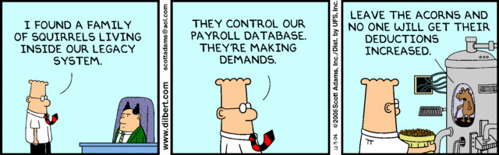
Rarely get to start with a clean slate
Typical Preconditions or Constraints for ITS Projects
Existing ITS Architecture and/or Plans
Existing Infrastructure
Electronic plan sets frequently available
Existing signs
Existing traffic control devices
Existing cabinets
Existing conduit plant
Nearby power and communications
You may be replacing or have to interface with a Legacy System!
Notes:
Purpose of Slide: Introduce setting the reality of the situation for your system concept
Key Message: ITS projects are frequently developed in an environment that already contains other transportation infrastructure
Time on Chart: 1 minute
Suggested Comments: Almost all ITS deployments take place along existing roadways. In the unusual case of new roadways, ITS will commonly be part of the design and the roadways are typically in locations with extensive ITS infrastructure. In either case, the ITS will not be developed in isolation, but will be integrated with existing infrastructure. For most ITS, existing plan sets will exist prior to the project based on either roadway construction or prior ITS implementations. In some cases, the plans will be available in electronic format suitable for modification using CAD systems. In other cases, the electronic versions of existing plans are limited to unmodifiable scans of full-sized paper plan sheets with hand-written red line revisions. Plans in both modifiable electronic format and plotted paper format will be required.
Legacy systems are defined as those systems that preceded the currently envisioned system and can be either replaced by the envisioned system or the envisioned system must interface with it. Legacy systems may not have a nice clean, documented interface and/or functional descriptions.
Transition:.
Interactivity:
Additional Resources:

Slide 16
Concept of Operations in the SE “V”
Notes:
Purpose of Slide: Show that the Concept of Operations is the initial activity in the SE V process
Key Message: Project definition starts with the ConOps
Time on Chart: 2 minutes
Suggested Comments: The Concept of Operations represents the initial definition of a project. The Concept of Operations takes into account previous concept studies and the needs of the stakeholders. It leads to the next step in the SE process, the requirements and system architecture.
Transition:
Interactivity:
Additional Resources:

Slide 17
Concept of Operations (ConOps)
A ConOps is written in conjunction with the stakeholders or users of the proposed system, in the users language and viewpoint and must be understandable by the users
The SE idea here is that we really want the proposed system to satisfy the stakeholder/user!
The most important part of a ConOps is capturing the user needs
In order for the ITS project to be successful, the user needs must be met by the project
Notes:
Purpose of Slide: Introduce the ConOps
Key Message: The ConOps is written for the users of the system in their language.
Time on Chart: 2 minutes
Suggested Comments: Note the word “Users” being underlined in addition to the term “user needs”. The users of the system are a subset of the stakeholders of the system. The ConOps is all about the users. It will define the user needs, which must be met by the project in order for the project to be successful. The user needs must come from the users or stakeholders and must be understandable by everyone involved in the project.
What is most important to understand about a ConOps? Capturing the correct user needs.
Transition:
Interactivity:
Additional Resources:

Slide 18
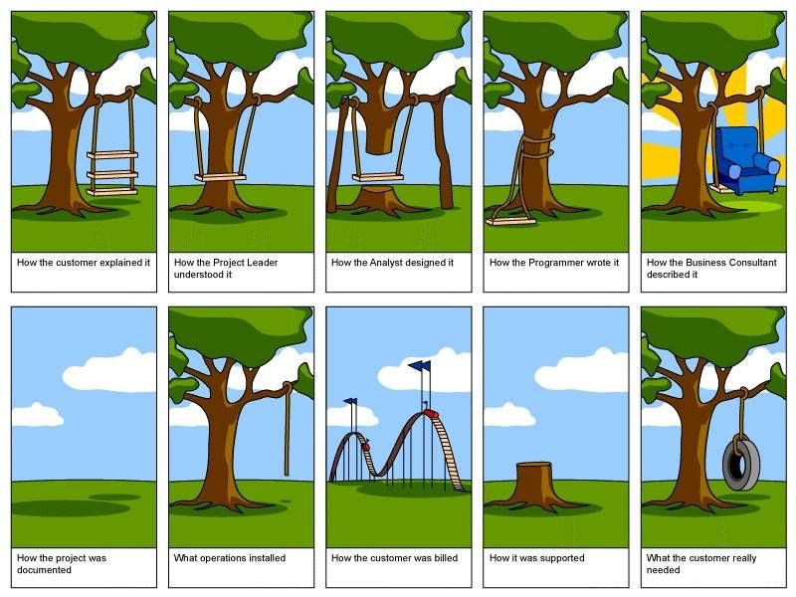
Managing Expectations
Notes:
Purpose of Slide: Illustrate and contrast the different perspectives of project expectations.
Key Message: Make sure you know what the user/customer expects and needs.
Time on Chart: 2 minutes
Suggested Comments: Walk through this example providing differing expectations of a project from perspectives of different people involved in stages of the project. Point out that the last graphic is what the customer really needed. The Concept of Operations is critical for getting the project off to the right start by capturing the user needs.
- How the customer explained it: customers sometimes are challenged to explain what they need.
How the project leader understood it: project leaders may not understand the nuances of how a system or project is put together.
How the analyst designed it: design undertaken without requirements can lead to systems that are impossible to implement
How the programmer wrote it: software really needs a firm grasp of the vision for a project.
How the business consultant described it: we’ve all heard salesmen build something up bigger than it needs to be.
How the project was documented: project documentation is vital to a project or systems longevity; after it’s built, there needs to be an explanation of how it was done.
What operations installed: it works but was it what the customer asked for?
How the customer was billed: cost/budget is an important part of the project/system criteria and needs to be understood at the outset
How it was supported: customer service often leaves the longest lasting impression on a customer
What the customer really needed: You can see that it is important that everyone, including the customer must be able to a articulate and understand the customer/user needs

Slide 19
Concept of Operations
Shows agreement on:
Goals, objectives, and expectations
Project scope and vision
Stakeholder roles and responsibilities
Operational Needs
How the system will operate
Operational and support environment
Notes:
Purpose of Slide: Purpose of ConOps
Key Message: The concept of operations should convey a high-level operational view of the project in layman’s terms.
Time on Chart: 2 minutes
Suggested Comments: Key word here is “agreement”, all of the sub bullets must be defined and everyone must be in agreement that the proposed system will be defined to meet this content in the ConOps.
Transition:
Interactivity:
Additional Resources:

Slide 20
Standards governing structure and content of a ConOps
There are a few standards that specify tailorable content in a ConOps
ISO/IEC/IEEE 29148:2011 – Systems and software engineering – Life cycle processes – Requirements Engineering
IEEE 1362-1998 – Targets software intensive and software only system development
ANSI/AIAA G-043-1992 – Revised standard in process of being approved in conjunction with INCOSE
Content in these standards is fairly consistent
Besides user needs, it is useful to explain the existing system that needs to be replaced, the motivation for new system changes and possible user scenarios
Notes:
Purpose of Slide: ConOps should follow a standardized outline
Key Message: Tailor the ConOps standard to suit your needs
Time on Chart: 2 minutes
Suggested Comments: Standards are available that specify the outline for a typical ConOps document, it is expected that the outline will be tailored for a specific project. However, there is critical ConOps content that should always be included. This critical content is being highlighted as part of this case study.
Although any of the standards can be used, it is recommended that the comprehensive ISO/IEC/IEEE 29148 standard be used. These standards are available for purchase from their respective standard development organization.
ISO = International Organization for Standardization
IEC = International Electrotechnical Commission
IEEE = Institute of Electrical and Electronics Engineers
ANSI = American National Standards Institute
AIAA = American Institute of Aeronautics and Astronautics
INCOSE = International Council on Systems Engineering

Slide 21
Purposes of a ConOps
Coalesce concepts of the System/Project
Document system foundational user operational needs and expectations
Describe how the system would operate to satisfy the user needs and expectations
Build consensus between the system users and the system developers
Notes:
Purpose of Slide: Emphasize the need for a ConOps
Key Message: ConOps provide the project or system vision
Time on Chart: 2 minutes
Suggested Comments: The ConOps provides the vision and concept of the project in documented form. The ConOps document describes all of the key aspects of the system. The development of the ConOps builds consensus between the system users and the system developers so that the resulting system will meet the user needs and expectations.
Transition:
Interactivity:
Additional Resources:

Slide 22
Concept of Operations Content
User Needs,
Operational Scenarios,
Stakeholders,
…
Notes:
Purpose of Slide: Begin to show what comprises a ConOps
Key Message: Introduce ConOps content
Time on Chart: 2 minutes
Suggested Comments: The Concept of Operations typically contains the following information: user needs, representative user scenarios, list of stakeholders with their roles and responsibilities as well as the existing system environment and any expected changes.
It is important to document this. Don’t assume that everyone knows the project concept.
Transition:
Interactivity:
Additional Resources:

Slide 23
Transit Operational Scenario Example
Marcel, a StarTran bus operator, usually begins his work shift with administrative activities. After receiving supervisory direction, he boards the bus and prepares the AVL (Automatic Vehicle Location) system. He begins by logging into the system.
The system then prompts Marcel for the route to be followed. He enters the planned route number, and the AVL system retrieves the appropriate route and schedule information from the AVL system server. The bus’ AVL system then asks Marcel to verify the appropriate route and schedule information were properly retrieved.
Once he provides verification, the bus’ head sign is automatically updated to reflect the appropriate route information. The fare payment schedule is automatically adjusted to reflect the verified route, modified as necessary by the system clock to reflect any applicable time-differential rates.
The system then loads the appropriate bus stop announcements for the chosen route. These prerecorded announcements are consistent regardless whether Marcel or another bus operator is driving the route, and have been verified as ADA compliant. These announcements are then broadcast at the appropriate bus stop throughout the route.
From StarTran AVL ConOps
Notes:
Purpose of Slide: Show an example of a operational scenario found in a ConOps
Key Message: ConOps operational scenario example for a Transit Automatic Vehicle Location (AVL)
Time on Chart: 2 minutes
Suggested Comments: This is an example of an operational scenario that includes some realistic detail that helps stakeholders immerse themselves in the scenario and visualize system operation. This is one of five scenarios that were developed for the City of Lincoln StarTRAN Automatic Vehicle Location (AVL) system to show the major system capabilities and the interactions between the Transit AVL system and its users and other interfacing systems.
Transition:
Interactivity:
Additional Resources:

Slide 24
What is a User Need?
Describes a major capability provided by a system
Should a system be developed without first knowing what it is expected to do?
Documented user needs are critical to assess/validate that a system does what it is supposed to do
The user specifies what the system is supposed to do in the form of user needs
User needs tend to remain stable over time
If needs change frequently, it would be impossible to build a system to satisfy them
This inherent stability of user needs forms the foundation for the system that can then be satisfied by changing technological capabilities
e.g., text-to-speech capabilities have greatly improved but the fundamental underlying user need to automate voicing text has not
Notes:
Purpose of Slide: Explain what is a user need
Key Message: User needs describe a major desired capability of the system
Time on Chart: 2 minutes
Suggested Comments: User needs are the basis for successful projects! They describe major capabilities that the system must satisfy. User needs should be fairly stable over time and different technologies can meet them as time goes on. For example the user need for connection to the internet to browse websites was initially met with a dial-up communications system but today can be met by a WiFi wireless communication system.
Transition:
Interactivity:
Additional Resources:

Slide 25
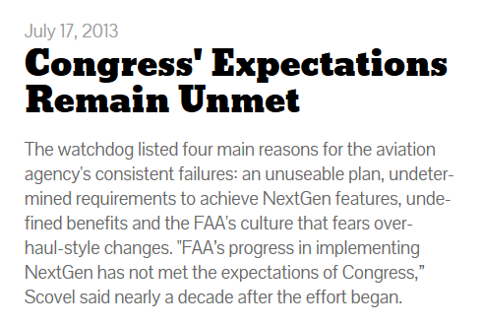
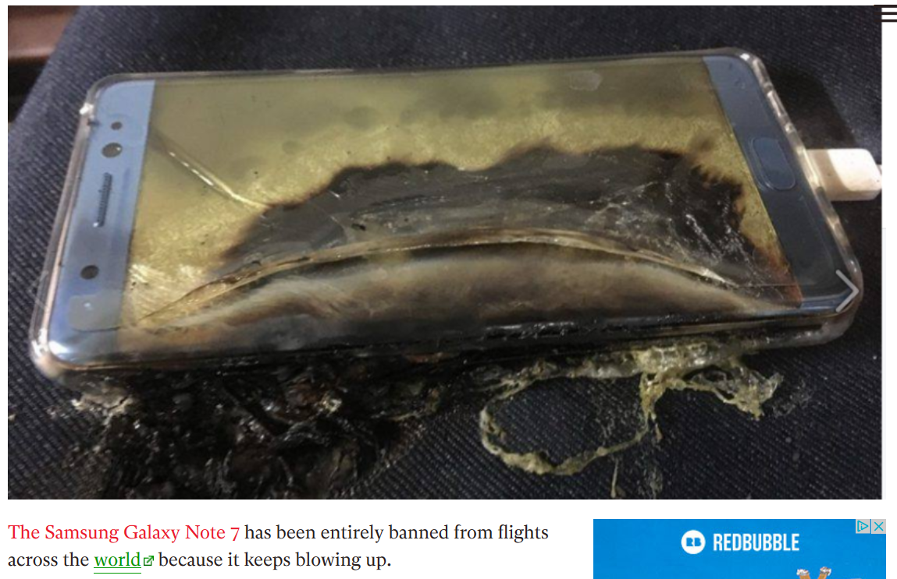
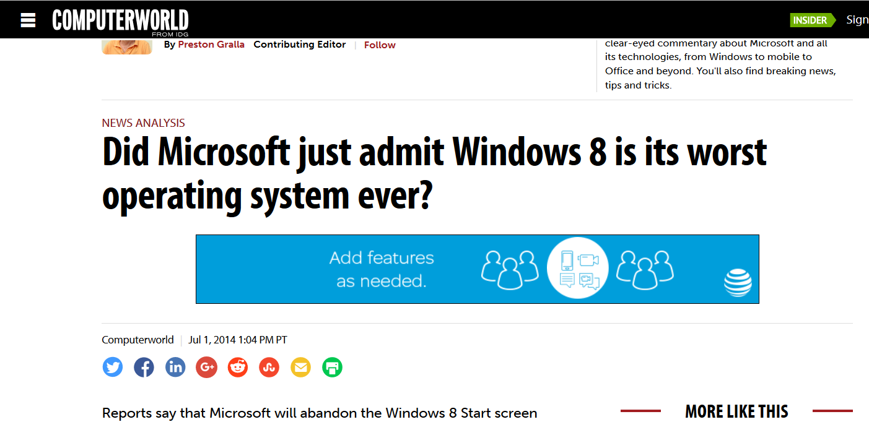
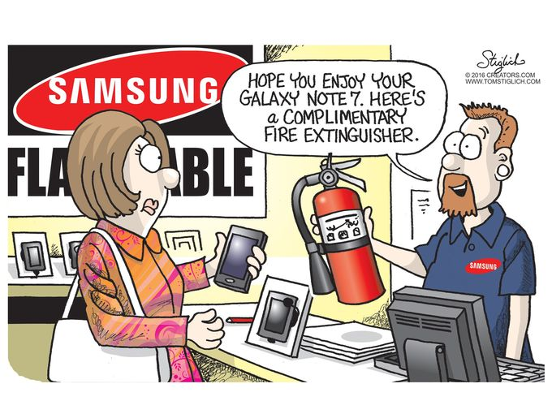
Some Examples of Not Meeting User Needs
https://en.wikipedia.org/wiki/Next_Generation_Air_Transportation_System
http://www.zdnet.com/article/five-reasons-why-windows-8-has-failed/
Notes:
Purpose of Slide: Associate system failures with not meeting user needs
Key Message: Projects/systems fail because the don’t meet user needs
Time on Chart: 2 minutes
Suggested Comments: There are many real world examples of systems or projects that don’t meet user needs.
Microsoft’s Windows 8 tried to update the Windows operating system to handle touch screens for the first time. One quote said “Windows 8 may have an OK tablet interface, but it's ugly and useless on the desktop. It requires users to forget everything they ever learned about Windows and learn an entirely new way of doing things for no real reason.”
The Federal Aviation Administration (FAA) has been trying to upgrade to a next generation air traffic control system the last 10 years and multiple billions of dollars.
The Samsung Galaxy Note 7 is another example of a device that didn’t meet user needs because it had a tendency to catch on fire and explode. Systems can be complex and it only takes one fatal flaw to ruin a very good product. Obviously, if the system is unusable it won’t meet user needs.

Slide 26
Transit Example Observations
From our transit scenario with Marcel a few observations can be made:
He needs to tell the AVL (Automatic Vehicle Location) system the transit bus route
The AVL system retrieves the route and schedule information
The bus head sign is updated with the route
Automatic fare payment system is adjusted for the route
Bus stop announcements are queued
Announcements broadcast where appropriate along the route
Notes:
Purpose of Slide: Make some observations about our previous transit scenario example
Key Message: Operational scenarios help everyone understand how users approach their system
Time on Chart: 2 minutes
Suggested Comments: Based on the Transit Automatic Vehicle Location example from a few slides ago, these sub-bullets list some of the operations and some of the needs that drive the operations for the envisioned system. As scenarios are developed they can help define user needs and vice versa. The resulting scenarios and user needs in a ConOps should be consistent with each other.
Transition:
Interactivity:
Additional Resources:

Slide 27
Criteria for Writing a “Well-Written” User Need
When documenting a user need, one must remember that it addresses an operational problem, and “describe” it using the following recommended criteria:
Provide a structure by assigning a unique number and title to make it uniquely identifiable
Identify a major desired capability (Including functions or features desired from the device/system)
Capture the rationale by stating why it is needed by the user.
Keep it solution-free: don’t get into how to meet it (design).
27
Notes:
Purpose of Slide: Explain what makes a well-written user need
Key Message: User needs must be well-written, described clearly, and address a problem
Time on Chart: 2 minutes
Suggested Comments: A system should not be procured or built without first knowing what it is expected to do. User needs convey that part. User needs help to assess/validate if a system does what the user wants it to do.
Four-point criteria to write a user need:
1. Uniquely Identifiable: Each need must be uniquely identified (i.e., each need shall be assigned a unique number and title).
2. Major Desired Capability (MDC): Each need shall express a major desired capability in the system, regardless of whether the capability exists in the current system or situation or is a gap.
3. Solution Free: Each need shall be solution free, thus giving designers flexibility and latitude to produce the best feasible solution.
4. Capture Rationale: Each need shall capture the rationale or intent as to why the capability is needed in the system.

Slide 28
Applying the Criteria: Transit AVL Example
UN 3.10 Configure Transit Vehicle Tracking System
Uniquely Identifiable
The Transit Operator needs to enter the bus route information into the transit vehicle
Major Desired Capability
in order for the transit vehicle to track its status against the route schedule and provide bus stop announcements.
Rationale
Note that this user need does not specify how this will be accomplished,
it only specifies the user need.
Solution-Free
28
Notes:
Purpose of Slide: Show an example of a well-written requirement
Key Message: User needs must meet all the criteria
Time on Chart: 2 minutes
Note that this slide reveals each line with a click of the mouse.
Suggested Comments: The Transit AVL example depicts a high level user need description and stresses all four elements of the criteria using animation
1. Uniquely Identifiable: User Need (UN) 3.10 numbering and the title
2. Major Desired Capability: The Transit Operator needs to enter the bus route information into the transit vehicle
3. Capture Rationale: in order for the transit vehicle to track its status against its route schedule and provide bus stop announcements. The Rationale will help you develop the Validation cases for the user needs.
4. Solution free, does not say how to accomplish the user need.

Slide 29
Transit AVL Example of Proposed System
As you begin to understand how the various pieces of the project fit together it is helpful to develop a block diagram
City Transit
Management Center
City Transit
Vehicle
Transit Vehicle
Operator
Transit Management
Center tracking Marcel’s
Bus
Marcel’s Bus
Marcel
Notes:
Purpose of Slide: Example of a Block Diagram
Key Message: It is useful to document how each system element connects to other system elements
Time on Chart: 2 minutes
Suggested Comments: We can analyze our Transit AVL scenario and develop a high-level block diagram that defines the scope and content of our proposed system. The boxes represent the system elements and the lines connecting the boxes show that there is some sort of communications between them.
In this example, first we model Marcel as a Transit Vehicle Operator, second his bus as a City Transit Vehicle and thirdly the City Transit Management Center which manages the fleet of bus. A part of the management is tracking the buses. Next we show lines connecting the system elements. In this example Marcel does not communicate directly with the City Transit Management Center, he only communicates through systems on his City Transit Vehicle.
Transition:
Interactivity:
Additional Resources:

Slide 30
Smart Phone Top 10 Feature List
10. Wireless Charging
9. Fingerprint Sensor
8. Infrared Remote Control
7. Plenty of Storage Space
6. Multiple Windows
Notes:
Purpose of Slide: Users often need help identifying their Needs
Key Message: Users often need help identifying their Needs
NOTE: The next to slides can be easily skipped in the interest of reducing lecture time.
Time on Chart: 2 minutes
Suggested Comments: Let’s take an example that may be more relatable to you. Many of you may have a smartphone. You have user needs associated with your smartphone. Your user needs will narrow your choices for the many types of smartphones in the marketplace. Users often use features they know thinking they are describing their “needs”. Here is a top 10 smart phone feature list with a nod to David Letterman.
Source: http://www.usatoday.com/story/tech/columnist/komando/2013/12/13/smartphone-battery-processing-display-camera/3921399/

Slide 31

Smart Phone Top 10 Feature List
5. Near Field Communications (NFC)
4. A Great Camera
3. Crystal-Clear Display
2. Warp Speed Processing
1. A Long-Lasting Battery
Notes:
Purpose of Slide: feature list continued
Key Message: Users often need help identifying their Needs
Time on Chart: 2 minutes
Suggested Comments: Continuing our list…
One issue you can see with this list is that many of the terms are ambiguous or open to interpretation, terms like “Long-Lasting”, “Warp Speed”, “Crystal-Clear”, “Great” can mean different things to different people. Also note that the fifth item “Near Field Communications” will greatly reduce your choices for a smart phone. Maybe you have seen commercials for this capability where the two smart phones are brought into close proximity to each other to share information like contact information.
Another thing to keep in mind is that this is not a list of user needs, this is a list of features that may or may not satisfy your user needs.
Another example could be that you need a smartphone that is waterproof since you expect to use it in the shower. In other words, your user needs directly affect your smartphone choices
Graphic: http://androidcommunity.com/sony-hires-supermodel-to-show-off-waterproof-xperia-z-smartphone-20130308/
Source: http://www.usatoday.com/story/tech/columnist/komando/2013/12/13/smartphone-battery-processing-display-camera/3921399/

Slide 32
ConOps development approach
Reality is that an ITS project will have constraints imposed on it
System concept must take into account both the user needs and constraints
Initial versions of the ConOps do not have to be perfect, changes will occur as further system development thinking occurs or the system environment changes
Change is inevitable, SE provides a way to manage change
ConOps document may need to be revised after the initial baselined version
Notes:
Purpose of Slide: Reality of developing a ConOps
Key Message: A ConOps document is meant to be a living document
Time on Chart: 2 minutes
Suggested Comments: Remember you rarely get to start with a clean slate. System concepts documented in the ConOps need to take into account the user needs as well as any constraints imposed on the system such as a particular hardware or software platform.
Part of the Systems Engineering process is managing change. The ConOps may change as you get further into the details in later stages of the Systems Engineering Process. These changes need to be managed to reduce scope creep which may affect schedule and budget.
Transition:
Interactivity:
Additional Resources:

Slide 33
Recommended ConOps Outline*
Document Scope
Reference documents
Current system or situation
Justification for change
Concepts for proposed system
Operational scenarios
Summary of impacts
Analysis of proposed system
Appendices
Glossary
* Based on ISO/IEC/IEEE 29148:2011 and IEEE 1362-1998
Notes:
Purpose of Slide: Introduce a recommended ConOps document outline
Key Message: List of the content of a ConOps based on the ISO/IEC/IEEE standard format
Time on Chart: 1 minute
Suggested Comments: This is a list of the recommended items to include in a Concept of Operations document as in the ISO/IEC/IEEE 29148 standard. We will walk through this list in the next few slides.
ISO = International Organization for Standardization
IEC = International Electrotechnical Commission
IEEE = Institute of Electrical and Electronics Engineers
Transition:
Interactivity:
Additional Resources:

Slide 34
Recommended ConOps Outline (cont)
1 - Document Scope
Document identification
Document overview
System raison d’etre
Briefly state why the system exists (if it does)
System Overview
From a summary level, what is the system
2 - Reference documents
Sources providing foundation for this ConOps
Includes standards and project-specific documents
Notes:
NOTE: Slides 34-38 can be skipped in the lecture, students can review the details of a Concept of Operations on their own.
Purpose of Slide: First 2 sections of a ConOps
Key Message: Scope and Reference Documents
Time on Chart: 2 minutes
Suggested Comments: The scope describes the system at a high-level establishing the boundaries and providing the purpose of the system and what it does.
The reference documents provide the sources upon which the system is based such as standards or documents describing the foundation of the system concept.
Transition:
Interactivity:
Additional Resources:

Slide 35
Recommended ConOps Outline (cont)
3 - Current system or situation
Most relevant for system updates and expansions
Provides context for statement of stakeholder need
4 - Justification for change
Evolution of system capability
User needs (Stakeholder needs)
Stated from the perspective of the user or stakeholder
Form the basis for system requirements
Need to be as comprehensive as possible
Description of desired changes
Notes:
Purpose of Slide: Next 2 sections of a ConOps
Key Message: Current situation and justification for change
Time on Chart: 2 minutes
Suggested Comments: The current system or situation describes the baseline of the existing system from which the updates will be made or the current situation within which a new system will be developed. It provides a basis for expressing the user needs.
The justification for change describes the user needs and describes system evolution. This provides justification for the project or the change to the system.
Transition:
Interactivity:
Additional Resources:

Slide 36
Recommended ConOps Outline (cont)
5 - Concepts for proposed system
Policies and constraints impacting the system
Description of the proposed system
6 - Operational scenarios
Provides an overview of the major operational uses of the system
What the system does
What people/organizations benefit from the system and how they benefit
What people/organizations operate the system and components
What people/organizations maintain the system and components
Scenarios examined should cover important expected situations
Notes:
Purpose of Slide: Next 2 sections of a ConOps
Key Message: System Concepts and operational scenarios
Time on Chart: 2 minutes
Suggested Comments: These 2 sections of the ConOps express the vision for the system or project. They explain the user’s perspective of the system operation and any constraints that must be taken into account. The scenarios includes the people and systems involved and how the interact and benefit from the system operation.
Transition:
Interactivity:
Additional Resources:

Slide 37
Recommended ConOps Outline (cont)
7 - Summary of impacts
Changes in operation
System costs
Acquisition
Operations and maintenance
Planned enhancements (if any)
Decommissioning (if any)
8 - Analysis of proposed system
Benefits
Limitations
Alternatives considered
Notes:
Purpose of Slide: Next 2 sections of a ConOps
Key Message: Summary of Impacts and system analysis
Time on Chart: 2 minutes
Suggested Comments: These two sections are defining the summary of expected impacts including cost and changes to operations as well as further analysis of the proposed system such as benefits, advantages, disadvantages and alternatives considered. This section should clearly describe why the proposed system is the best choice.
Transition:
Interactivity:
Additional Resources:

Slide 38
Recommended ConOps Outline (cont)
9 - Appendices
Material important to be available for reference
Portions of reference documents
Unpublished analysis or rationale
Data relevant to operational concepts
10 - Glossary
Notes:
Purpose of Slide: Last 2 sections of a ConOps
Key Message: Appendices and Glossary
Time on Chart: 2 minutes
Suggested Comments: These two sections include appendices as a catch-all for anything deemed important to reference in support of the main sections of the ConOps and a Glossary which is useful to define consistent terms.
Transition:
Interactivity:
Additional Resources:

Slide 39
ConOps User/Stakeholder Review
Do not develop a ConOps in a vacuum
Must include input from the users/stakeholders
Schedule a time to review the ConOps with everyone involved
How do you know when all the ConOps and user needs are defined?
All Major Desired Capabilities are captured in the document
General group consensus that the ConOps fully explains the proposed ITS project/system
Notes:
Purpose of Slide: ConOps Development considerations
Key Message: ConOps Development considerations
Time on Chart: 2 minutes
Suggested Comments: Explain each bullet to the students, it is critical to include the users in developing a ConOps. The users are the ones who have to be satisfied with the final system.
It is sometimes hard to know when you have completely defined everything you will need to document the system in the ConOps. Since the ConOps is a living document, if something else is found in a later SE stage such as the requirements, there should be some project contingency funding and schedule to accommodate changes.
Transition:
Interactivity:
Additional Resources:

Slide 40
Exercise Case Study Overview
Develop Stadium Expansion Concept of Operations Case Study
Scenario
University Football Stadium traffic congestion
Planned events
Growing attendance/traffic
Stadium expansion
City transportation system cannot accommodate demand
Student Role
City Traffic Engineer
Systems Engineer
Resources
ConOps outline
Notes:
Purpose of Slide: Preview the exercise.
Key Message: In the exercise, students will define some draft input to a set of stakeholder user needs for the PCB Case Study from the perspective of the traffic engineer working for the city.
Time on Chart: 1 minute
Suggested Comments: The exercise you will be doing in Component 2 develops some of the parts of a Concept of Operations including a list of stakeholders or users, their corresponding systems or elements as well as an initial set of stakeholder user needs for the University Stadium Case Study. The project scenario revolves around a university football stadium and the traffic congestion that has begun to be a problem during games. In this exercise scenario, our football team has been having increasing success over the past few years and attendance at games has increased to stadium capacity. This capacity draw has put enormous strain on the roadway network around the stadium to the point where the City has to find a solution to remedy the problem because of the traffic congestion on game day. On top of that, the university, playing on the success of the team and the requests of alumni, has decided to expand the stadium capacity which will magnify the congestion problem.
Your role in the exercise will be that of a City Traffic Engineer who needs to use Systems Engineering. Your task will be to assure that the needs of the city, university and state are accurately and completely represented in a draft ConOps.
Transition:
Interactivity:
Additional Resources:

Slide 41
Exercise Activities
Task 1: Identify Stakeholders
Determine who is involved
Roles and Responsibilities
Task 2: Current Situation
Operations
System Elements and Connections
Task 3: Justification for Change
User needs
Description of Desired Changes
Task 4: Concepts for Proposed System
Policies and constraints impacting the system
Description of the proposed system
Identify Stakeholders
Current Situation
Justification for Change
Concepts for Proposed System
Notes:
Purpose of Slide: Review the exercise tasks.
Key Message: The exercise will consist of 4 tasks.
Time on Chart: 1 minute
Suggested Comments: The exercise will consist of 4 tasks as listed on this slide. The objective is to define the concept of the project with added elements in each step.
Task 1 will identify the stakeholders.
Task 2 will explain the current situation.
Task 3 will produce a justification for changes.
Finally, Task 4 will develop supporting concepts for the proposed system.
Transition:
Interactivity:
Additional Resources:

Slide 42
Case Study Purpose
Provide understanding of systems engineering
Gain experience in beginning development of a systems project with a Concept of Operations
Explore balancing priorities in establishing project scope
Notes:
Purpose of Slide: Conduct a review to ensure students understand the purpose of the case study.
Key Message: Confirm that case study provided an overview of Concept of Operations development applied to ITS, explored its application to transportation problems and exposes students to the roles needed for System Engineering to proceed.
Time on Chart: 1 minute
Suggested Comments:
Ask questions such as the one below to ensure that students understand the purpose of the case study.
What does a ConOps provide?
Possible Answers:
User Needs
System/Project environment
User Vision for system operation
Transition:
Interactivity:
Additional Resources:

Slide 43
Take Home Exercise
Review Component 2 – Concept of Operations Exercise material
Understand your role and the project environment description
Task 1 – Identify the Stakeholders
Task 2 – Determine the Current Situation
Task 3 – Justification for Change
Task 4 – Concepts for the Proposed System
Notes:
Purpose of Slide: Review Take Home Exercise
Key Message: Make sure the students understand the take home exercise
Time on Chart: 2 minutes
Suggested Comments: As you read through the take home exercise material, you will be extracting the important information that will need to be captured in a Concept of Operations document. You should not spend more than 2 hours on this exercise. It is also okay to expand the scope of the project if something is unclear. The idea behind the initial draft of a ConOps is to explore the project’s options as you determine the appropriate scope and the involved stakeholders. The ConOps can always be changed to reflect the reality of budgets and schedules.
Transition:
Interactivity:
Additional Resources:

Slide 44

Benefits of Developing a Concept of Operations
Early stakeholder agreement on:
System capabilities
Roles and responsibilities
Key performance measures and a basic plan for system validation
Manage stakeholder expectations
Start with Your Eye on the Finish Line
A ConOps helps the project team visualize the final system at the beginning of the project.
Notes:
Purpose of Slide: Review Key Benefits of a ConOps
Key Message: Review Key Benefits of a ConOps
Time on Chart: 2 minutes
Suggested Comments: The benefits of developing a ConOps include coming to agreement with everyone involved regarding the system capabilities and scope of your project as well as managing stakeholder expectations.
The ConOps is a tool that helps the project team visualize the final system. Yes, it is possible that changes will occur as the project progresses but it is better to have a firm grasp of the system capabilities as you begin further system analysis of the project.
Transition:
Interactivity:
Additional Resources:

Slide 45
ConOps Summary
The ConOps document:
Captures the important user needs (major desired capabilities)
Written in the User/Stakeholder’s language
Helps everyone understand the system operations and the scope of the system
Includes background and scenarios for the system
Provides a basis for Systems Engineering traceability through system validation testing
Notes:
Purpose of Slide: Summary of ConOps document content
Key Message: Summary of ConOps document content
Time on Chart: 2 minutes
Suggested Comments: Summarize the contents of and purpose of a ConOps as the class wraps up. The class should fully understand these bullets by now.
Transition:
Interactivity:
Additional Resources:

